Slide 1
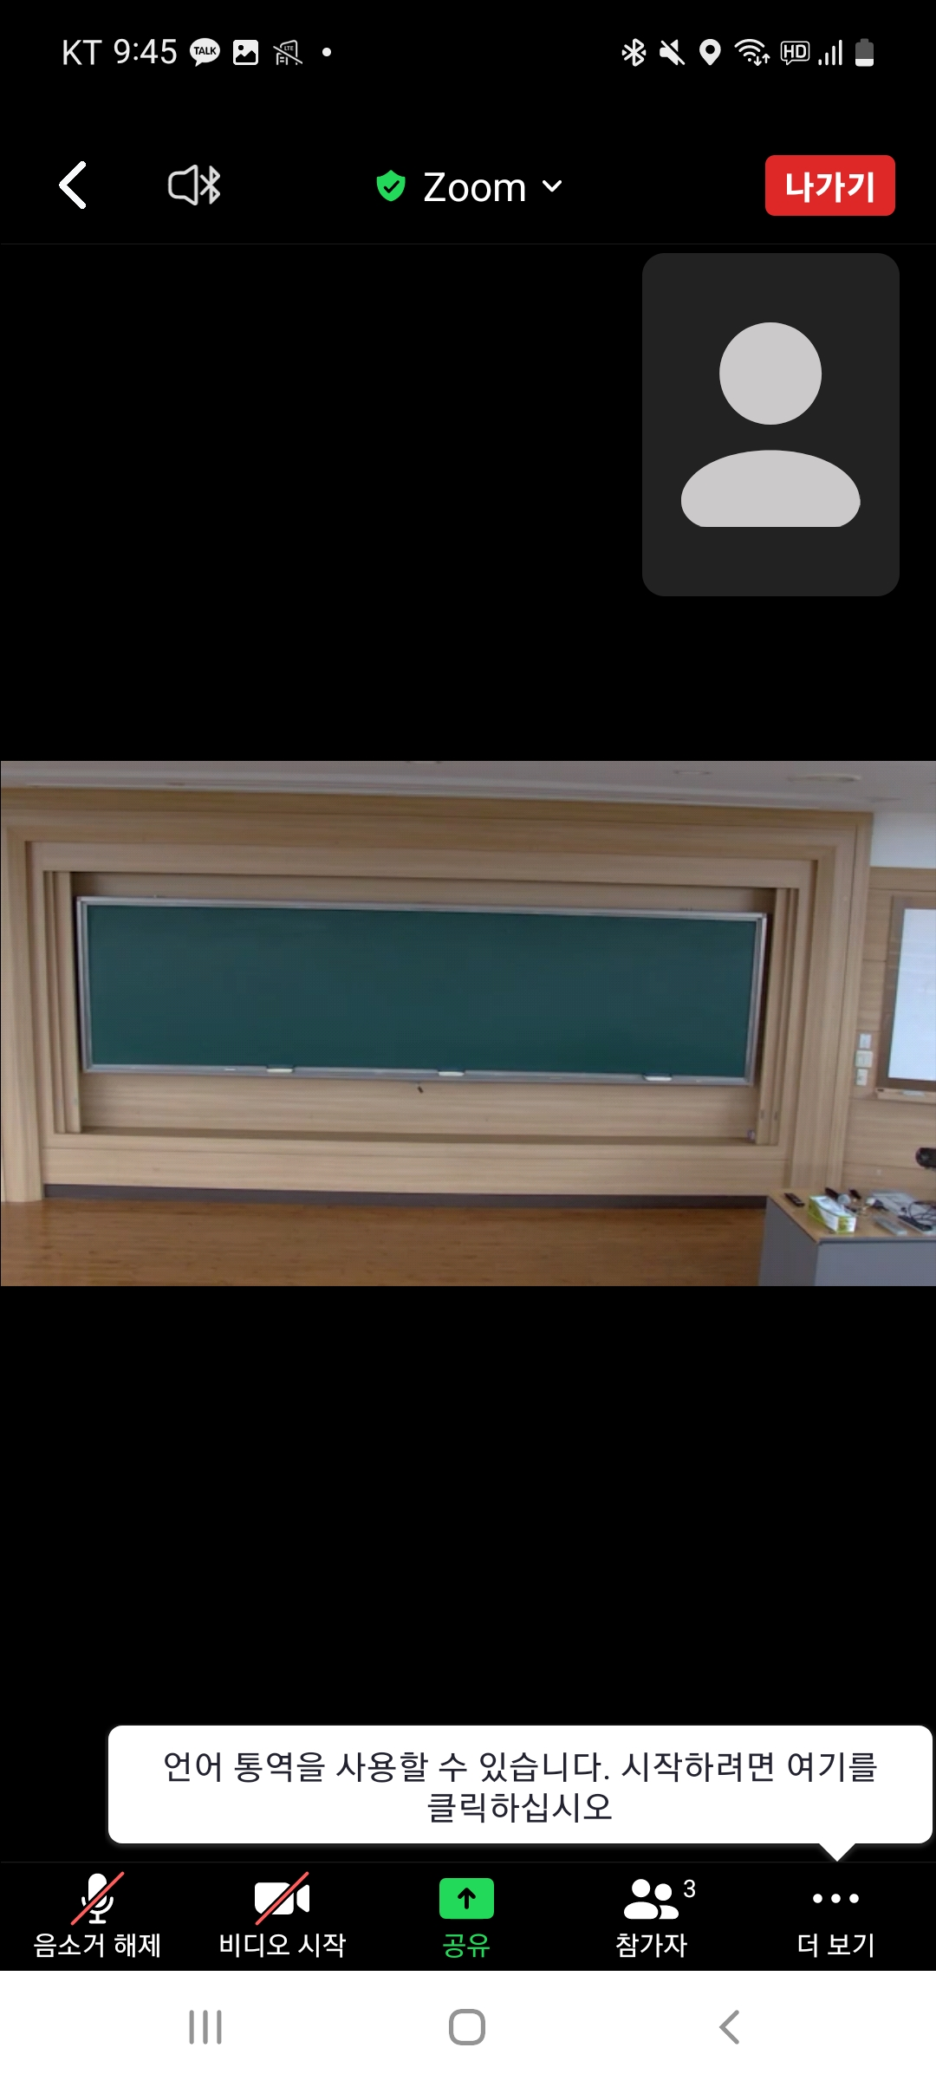
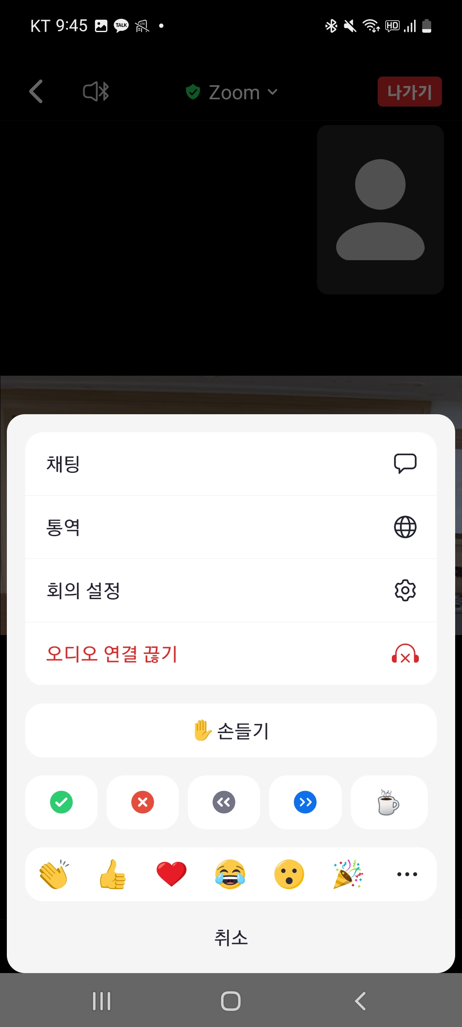
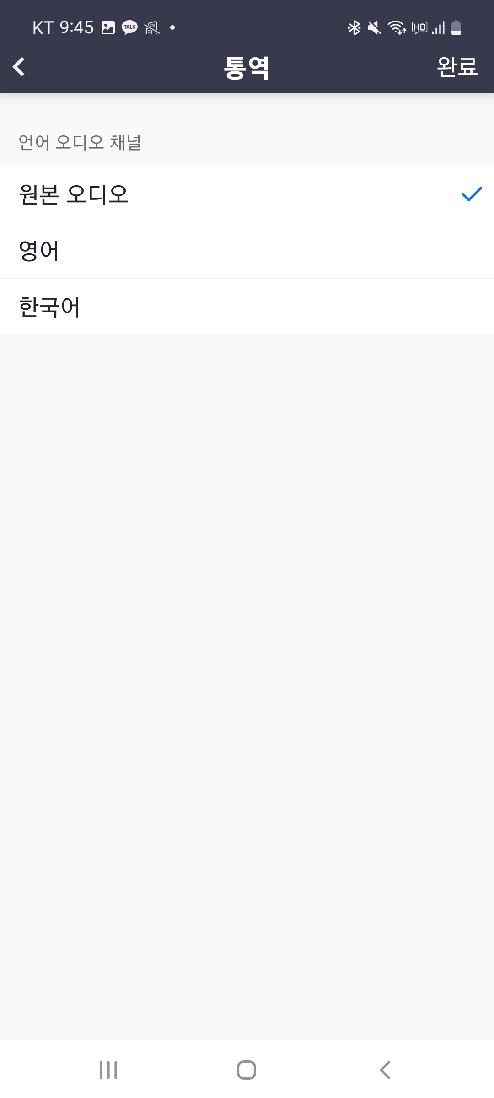
[Mobile] Activate Translation
Original Sound
English
Please press “Translate”
Please choose English
Translate
After access Zoom on Mobile,
Select 'View more' below

Slide 2
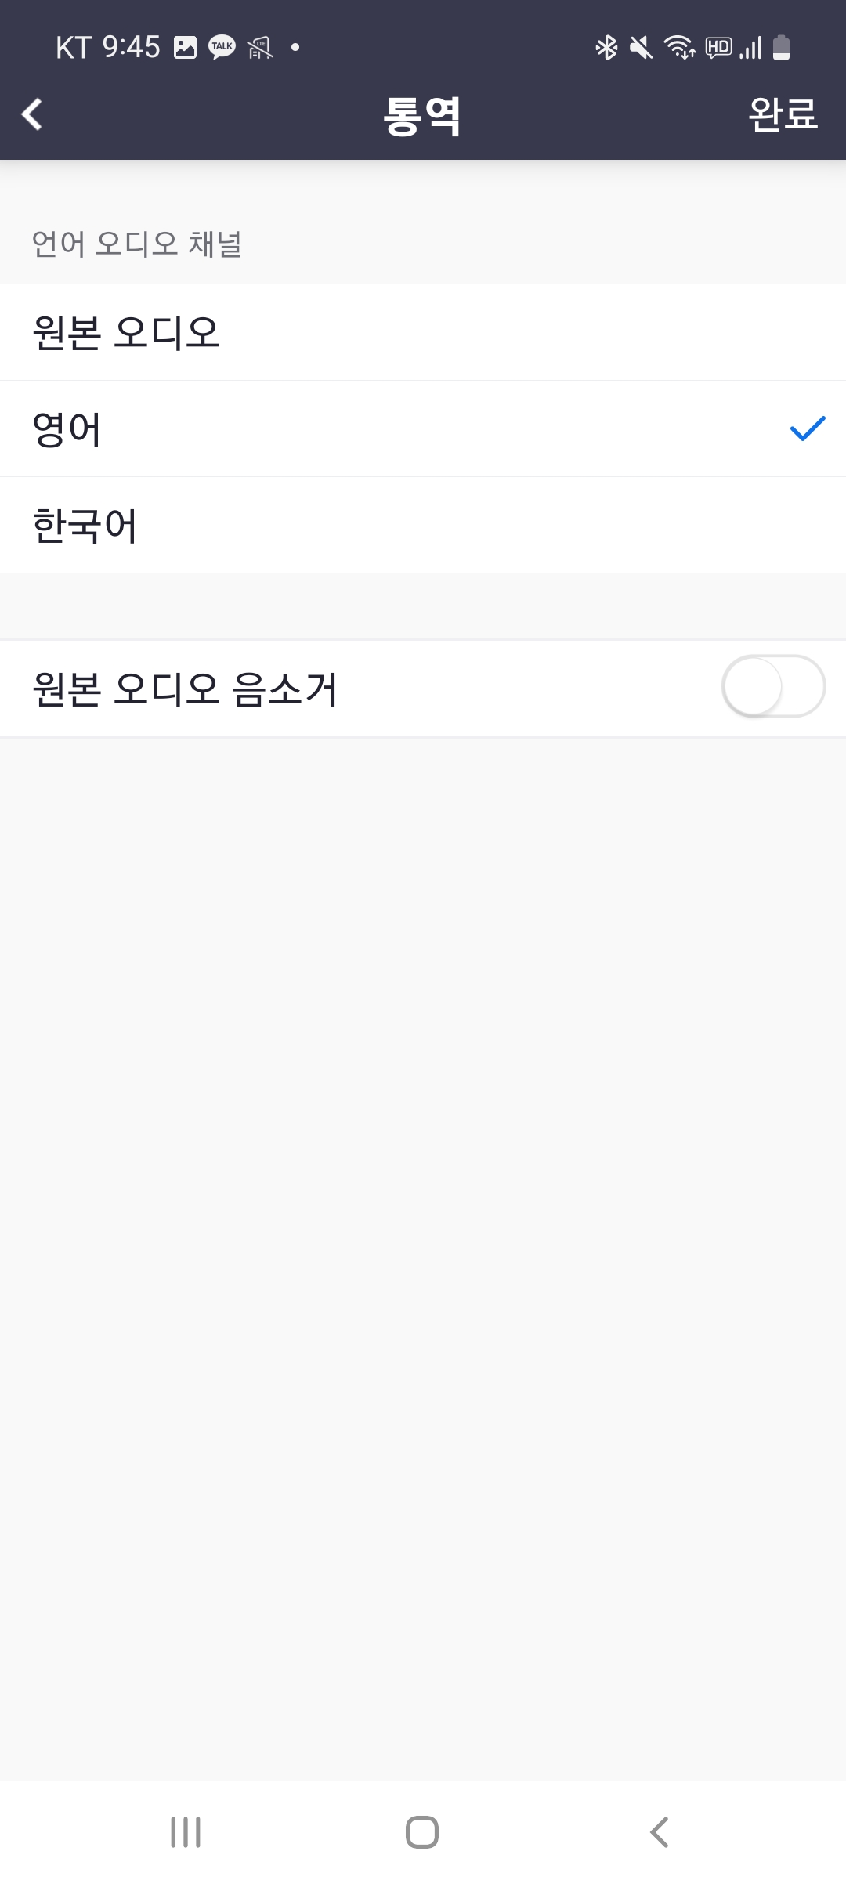
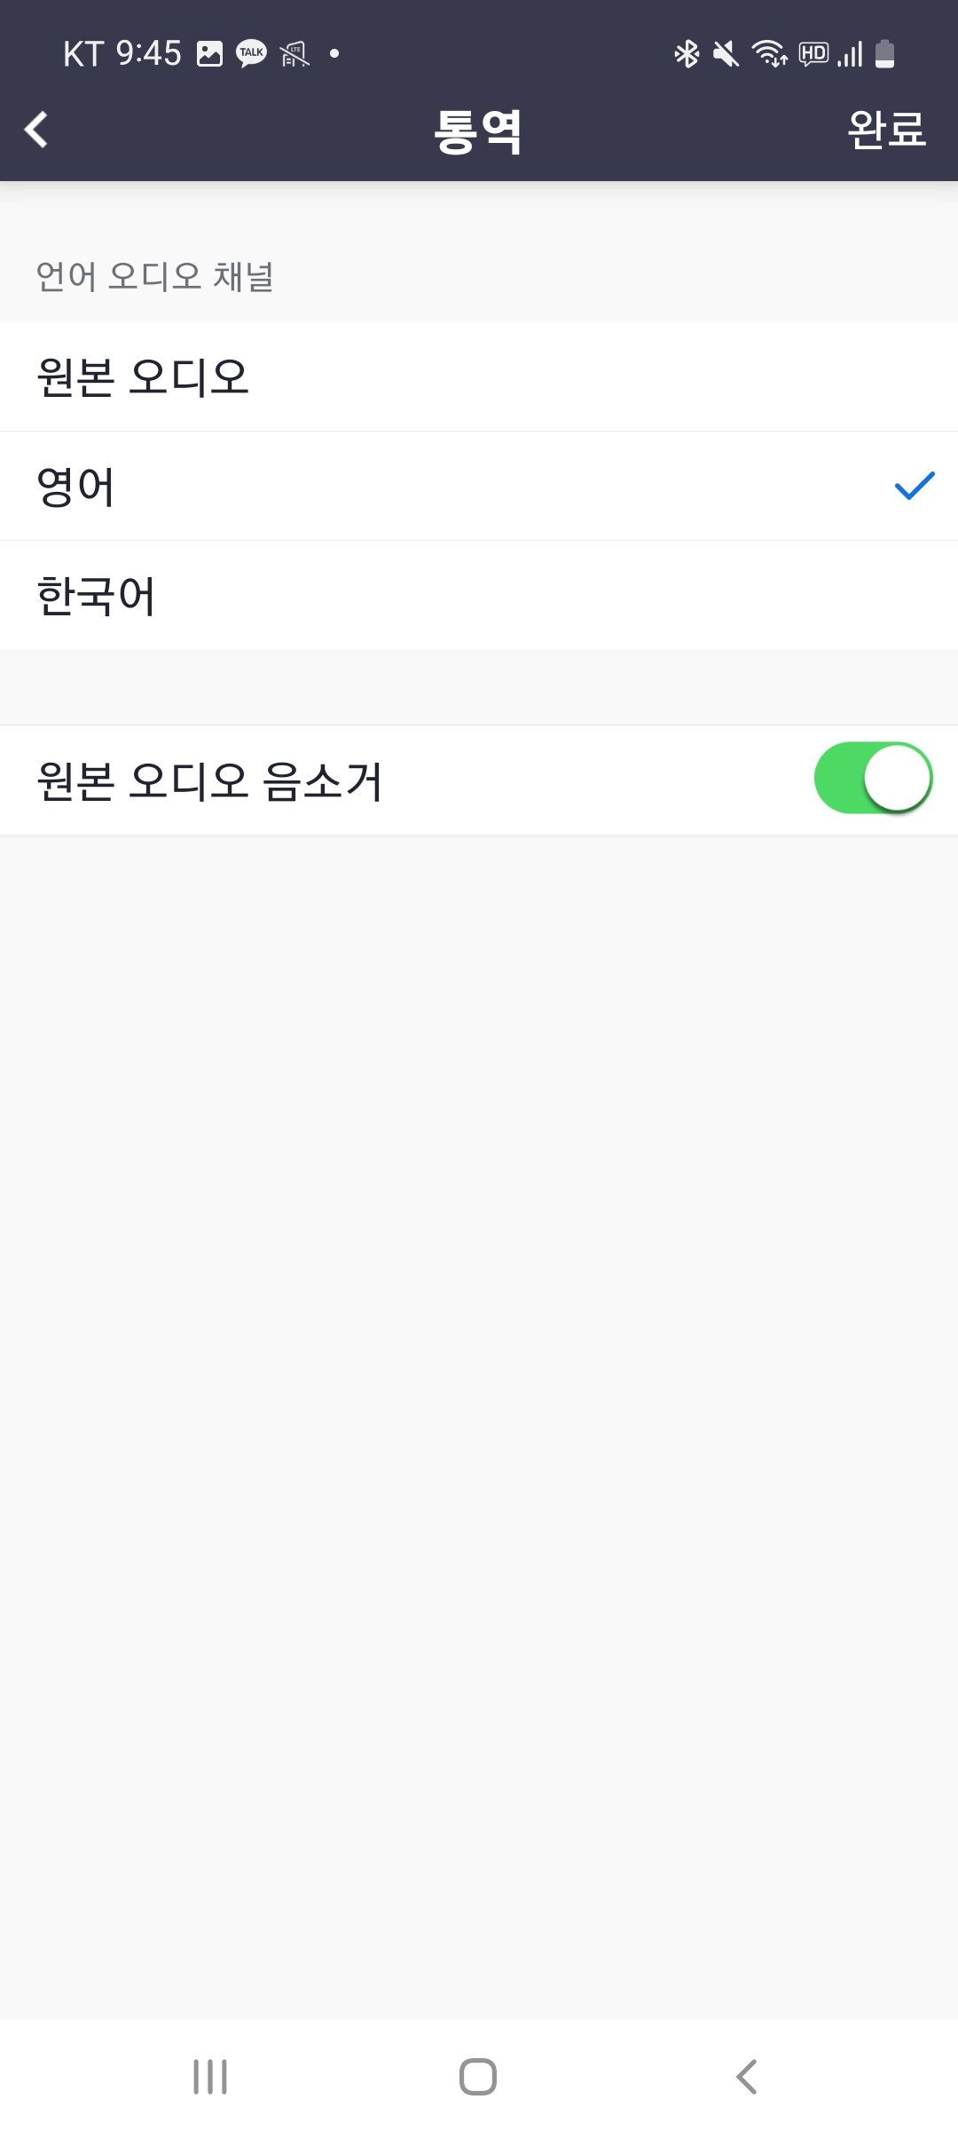
[Mobile] Activate Translation
Original Sound
Original Sound
English
English
Mute original sound
If you mute the original audio, you can only hear the English interpreter audio.
Otherwise, the speaker's words and simultaneous interpretation will be heard at the same time.

Slide 3
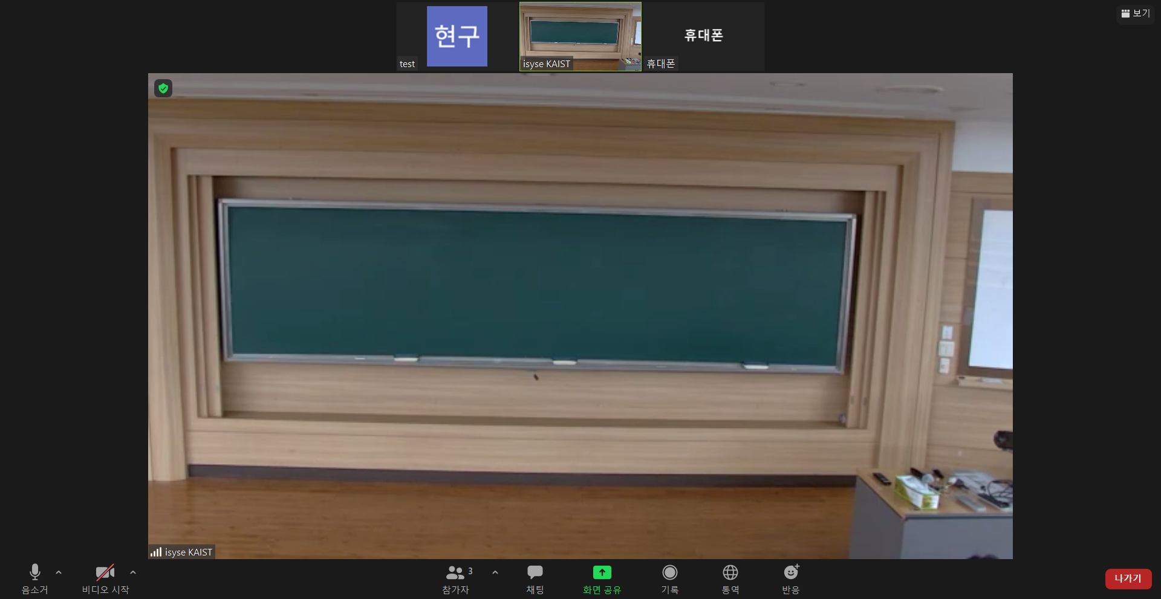
[PC] Activate translation
After connecting to Zoom, please click on the interpretation button at the bottom

Slide 4
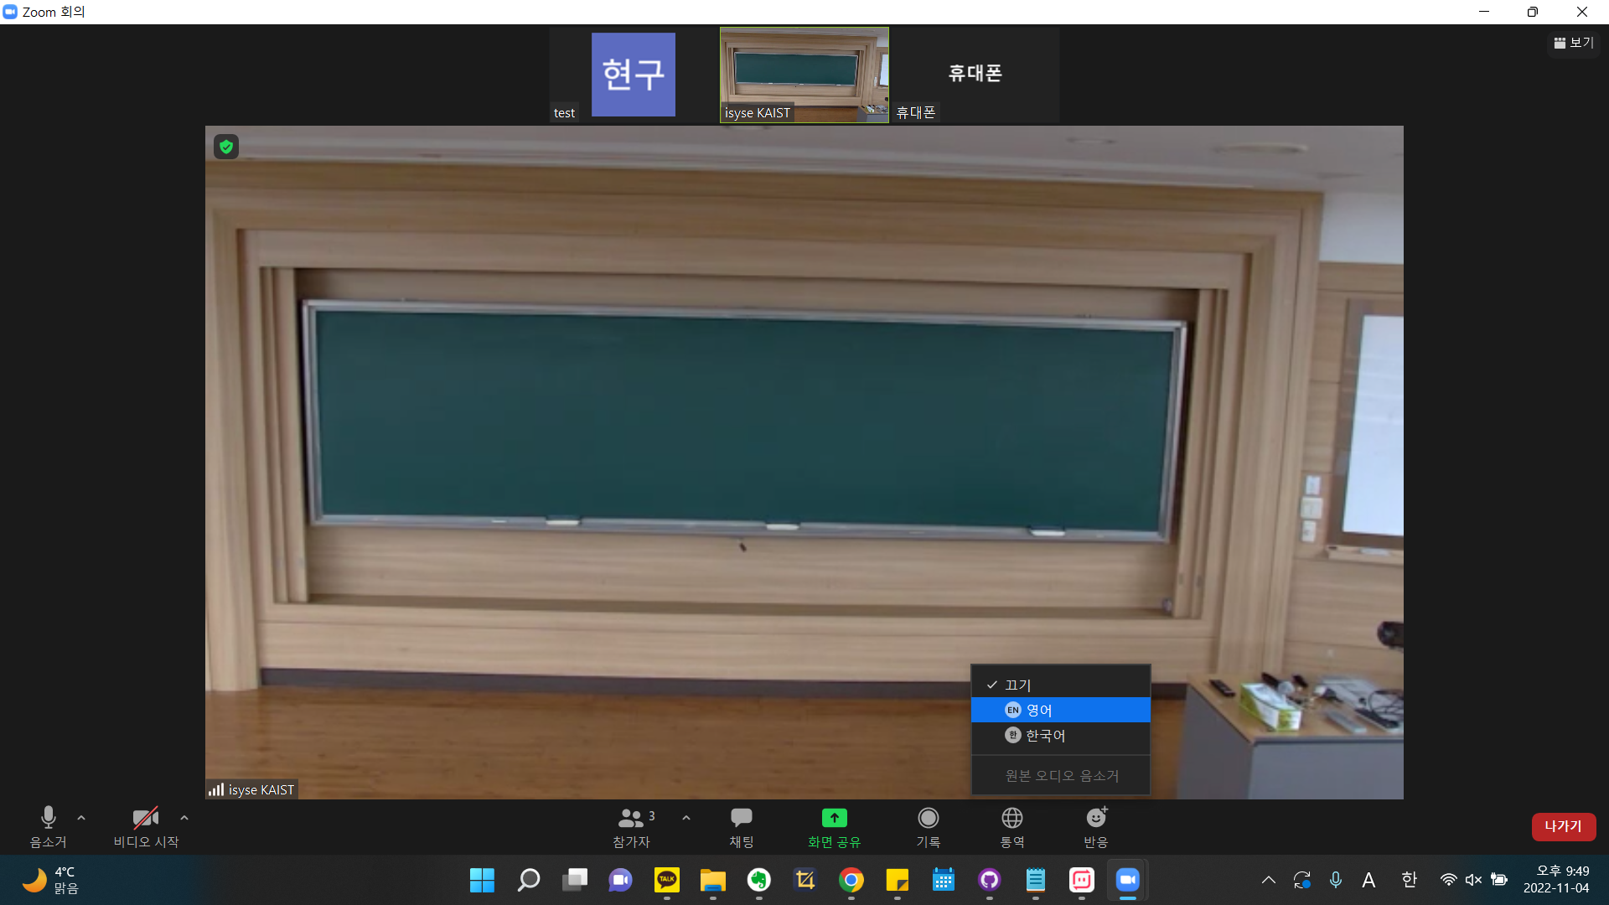
PC/노트북 통역 기능 활성화
Please choose English. You can set whether to mute the original audio below.
English

